Slide 1
IBM HR Analytics Employee Attrition Kaggle
DS 120 Final Project
Ahmad M. Osman

Slide 2

Well, where do you want to work?

Slide 3
Goal: Predicting Employee Attrition
Multiple Regression
Dividing Data Set Into
Training Set
Test Set
Normalize The Data ~ Everything falls between a zero and a one
Scaling Through Equation
Using One Hot Encoding
Minimizing the Mean Square Error(MSE) Using Solver
Finding Coefficients Values That Lead To Best Prediction Values

Slide 4
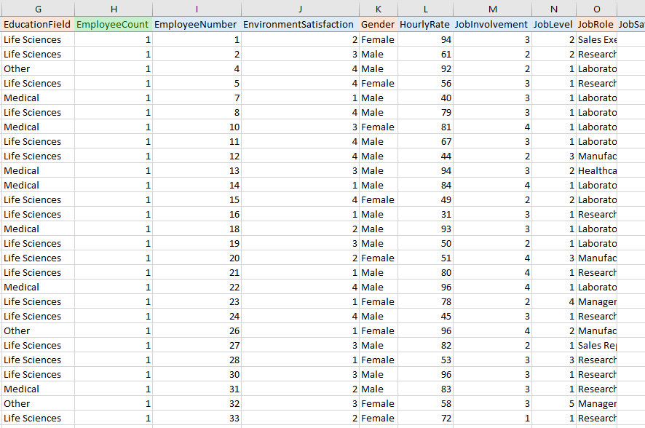
The Data
1471 Rows
Training Set: 1176 Rows
Testing Set: 296 Rows
50 Variables

Slide 5
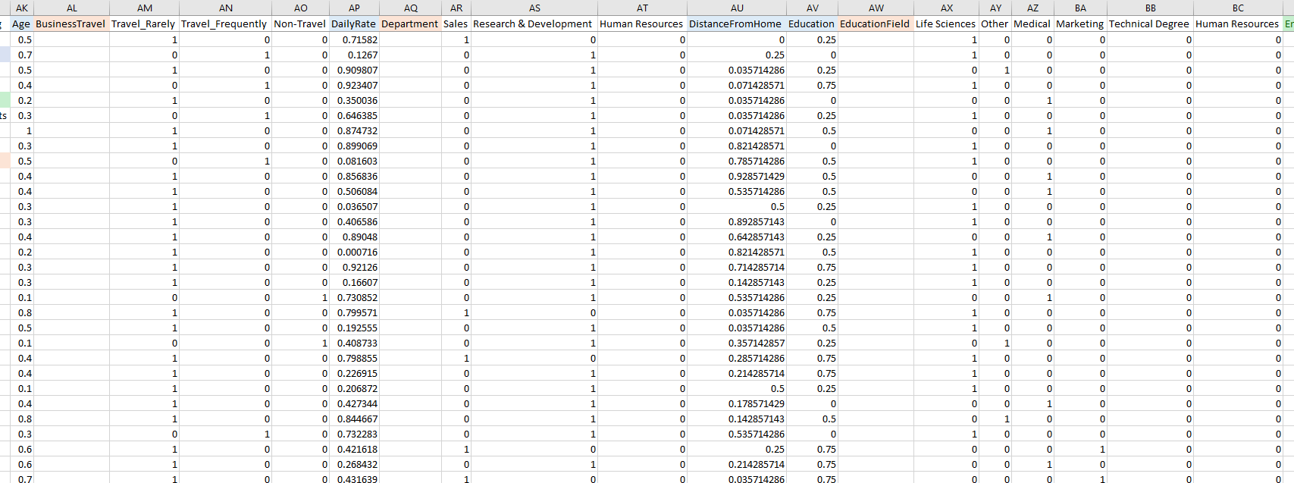
Data Cleaning, Scaling & Normalization

Slide 6
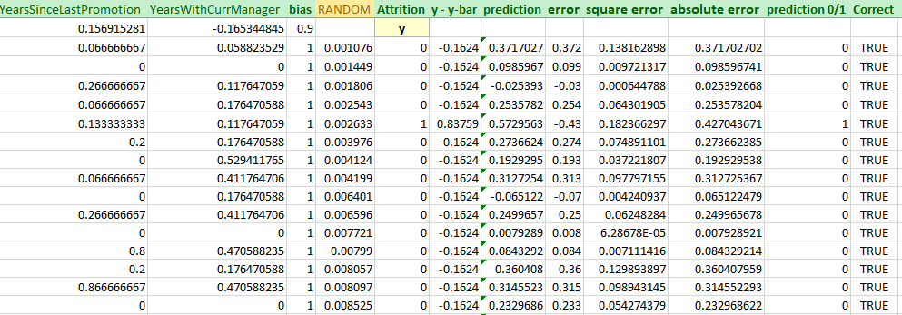
Calculations

Slide 7
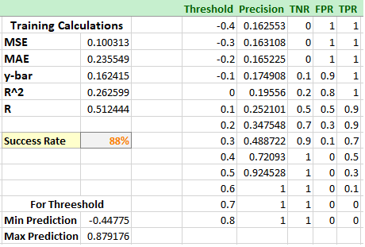
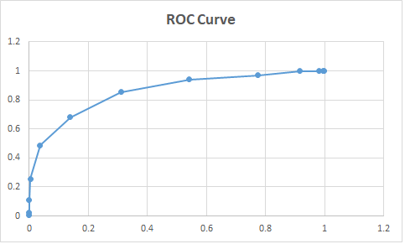
Threshold Boundaries, RCO & Success Rate
Threshold Boundaries
Graph Between FPR & TPR

Slide 8
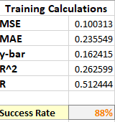
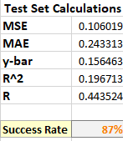
Comparison Results: The Model Can Predicted Attrition 88% Of Time Successfully.
Heaviest Coefficient: Years at the company

Slide 9
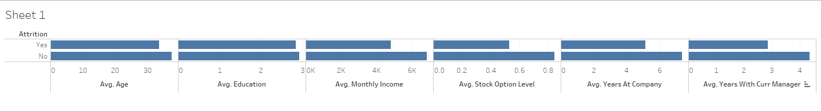
Insights
Attrition: yes = 237, no = 1233

Slide 10
Future Suggestions
Predicting Salary
Predicting Stock Option
Predicting Years At The Company

Slide 11
Thank You!

